Slide 1
Multi-channel Queue
THE CALL CENTER

Slide 2

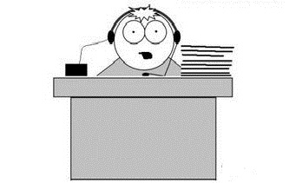
Multi-channel Queue
Baker
Able

Slide 3
Multi-channel Queue - Arrival of a Customer
Arrival Event
Is Able Idle?
Yes
Customer enters service
No
Customer enters queue for service
No
Is Baker Idle?
Yes
Customer enters service
Unit-entering-system flow diagram

Slide 4
Multi-channel Queue - Departure of a Customer
Departure Event
Begin server idle time
No
Another customer waiting?
Yes
Remove the waiting customer from the queue
Begin servicing the customer
Service-just-completed flow diagram

Slide 5
Multi-channel Queue
We need to the system measures of system performance in terms of:
The efficiency of Able.
The efficiency of Baker
The average caller delay.

Slide 6
Multi-channel Queue - System Design
Server Selection: [How to select a server when both servers are available?]
Highest Priority
Each server should be assigned a priority
When a customer arrives, it enters the available server having the highest priority
Random
Choose any server of the available servers
Least utilization [Bonus]
When a customer arrives, calculate the utilization of the available servers
The customer enters the server having the least utilization, i.e. the server that worked the least amount of time since the system has started running.

Slide 7
Multi-channel Queue - System Design
System Variables
Arrival Time(i) = T_{i}
Interarrival Time(i) = A_{i} = T_{i} – T_{i-1}
Service time(i) = S_{i}
Waiting Time(i) = D_{i}
Departure Time (i) = C_{i} = T_{i} + D_{i} + S_{i}
S and A are stochastic variables (generated according to probability distribution)

Slide 8
Multi-channel Queue - System Input
Inter-arrival time distribution
Number of servers
Service time distribution for each server
Server Selection method (priority, random, least utilization[BONUS])
Stopping Condition
Maximum Number of customers
Simulation end time

Slide 9
Multi-channel Queue - System Output
Results table including these columns:
Customer No
Random Digit for inter-arrival time
Inter-arrival time
Arrival time (Clock Time)
Random Digit for service duration
Service duration
Server Index
Time Service Begins
Time Service Ends (Departure)
total delay time for this customer (Time in queue)
N.B: Assume Server 1 has higher priority

Slide 10
Sample Testcase

Slide 11
Multi-channel Queue - Sample Input
Interarrival Distribution of calls
Interarrival Time | Probability | Cumulative probability | Rang
1 | 0.25 | 0.25 | 01-25
2 | 0.40 | 0.65 | 26-65
3 | 0.20 | 0.85 | 66-85
4 | 0.15 | 1 | 86-00

Slide 12
Multi-channel Queue - Sample Input
Able’s Service Time distribution
Service Time | Probability | Cumulative probability | Range
2 | 0.30 | 0.30 | 1-30
3 | 0.28 | 0.58 | 31-58
4 | 0.25 | 0.83 | 59-83
5 | 0.17 | 1 | 84-00

Slide 13
Multi-channel Queue - Sample Input
Baker’s Service Time distribution
Service Time | Probability | Cumulative probability | Range
3 | 0.35 | 0.35 | 1-35
4 | 0.25 | 0.60 | 36-60
5 | 0.20 | 0.80 | 61-80
6 | 0.20 | 1 | 81-00

Slide 14
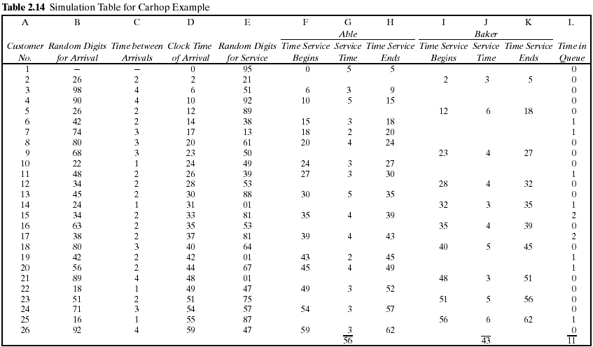
Multi-channel Queue - Sample Output

Slide 15
System Output - Performance Measures
Calculate the Measures of Performance for the system:
Average waiting time (in the queue).
Maximum queue length.
Probability that a customer wait in the queue.
Per Server:
Average service time per server.
Utilization of each server
Probability that a server is in idle state.
Do we need extra server? Why?!!

Slide 16
System Output - Performance Measures
Measure system performance by calculating the following variables:
Maximum queue length during simulation runtime.
Notes:
Total number of customers : number of customers that have entered the server
Total time customers waited in queue : the sum of delay time of the customers that entered the server
Number of customers who waited: number of customers that have entered the server and having delay time > 0

Slide 17
System Output - Performance Measures Per Server
Measure servers' performance by calculating the following variables:
Notes:
Total number of customers : number of customers that have entered the server
Total time customers waited in queue : the sum of delay time of the customers that entered the server
Number of customers who waited: number of customers that have entered the server and having delay time > 0

Slide 18
Multi-channel Queue – Graph
Required Chart
Server Busy Time [One for every server]
X-axis : time
Y- axis : it has a value of 1 if the server is busy or zero if the server is idle

